Slide 1
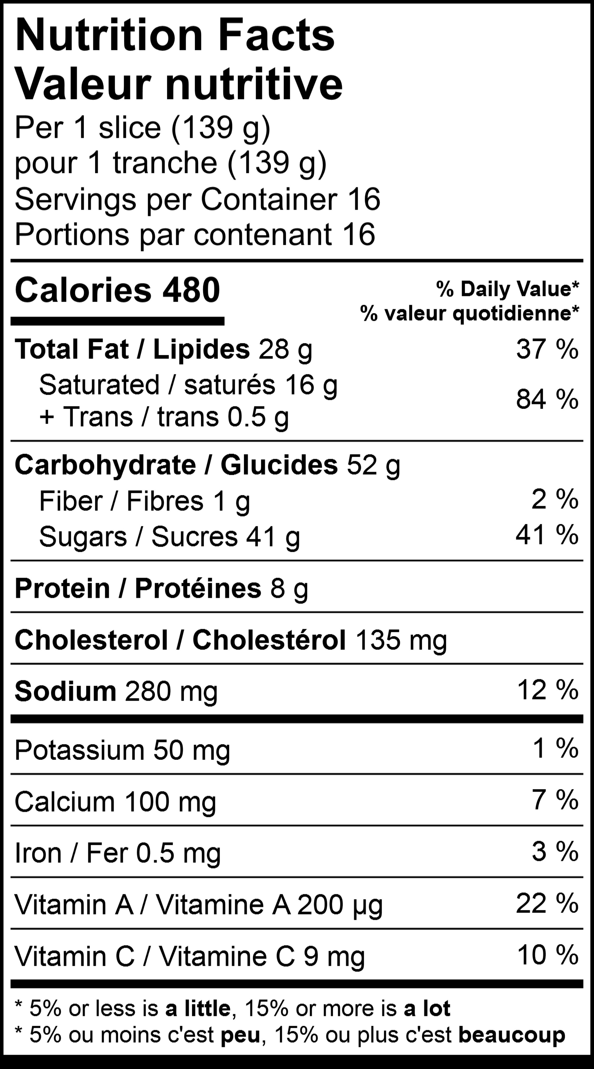
Product Specifications / Fiche Technique
White Chocolate Lemon Cheesecake / Gâteau au fromage au citron au chocolat blanc
Product Description:
Homemade lemon custard and white chocolate cheesecake are baked on a buttery graham base. Topped with lemon mousse, a swirl of lemon custard and delicate white chocolate curls.
WOW SKU | SCC/ GTIN | UPC | Size | Units Per Case | Portions per Unit | Case Dimensions (L x W x H) | Pallet Ti x High
1354 | 10778463013543 | 778463013546 | 25.4 cm 10 inches | 2 / 2.22kg 2 / 4lb 14oz | 16 / 139g 16 / 4.90oz | 32.03 x 30.01 x 17.00 cm 12.67 x 11.81 x 6.69 in | 12 x 7
Shelf Life: 365 days frozen, 3 days thawed if refrigerated.
Preparation & Handling
• Keep product frozen at -18°C (0°F).
• For best results, cut and handle product partially frozen. • To defrost, leave in fridge overnight. A single slice at room temperature will defrost in about an hour.
• To store remaining product, ensure the paper dividing slices remain on the cutting edge to protect cake from drying out. Cover cake and place in refrigerator to ensure freshness.
• For more information and product handling, visit our website at wowfactordesserts.com/storage-handling-tips/
www.wowfactordesserts.com

Slide 2
White Chocolate Lemon Cheesecake:
Ingredients: Cream cheese (milk ingredients, salt, bacterial culture, carob bean gum, sorbic acid), Sugars (granulated sugar, icing sugar), Egg, Sour Cream, Chocolate (sugar, cocoa butter, whole milk powder, soy lecithin, natural vanilla flavour), Graham crumbs (flour, graham flour, sugar, palm oil, high fructose corn syrup, molasses, salt, sodium bicarbonate), Whipping cream (cream, milk, carrageenan), Milk, Water, Canola oil / modified palm and palm kernel oil margarine, Lemon puree concentrate, Wheat flour, Butter, Modified Food starch, Buttermilk powder, Modified Tapioca Starch, Gelatin, Cinnamon.
Contains: Wheat, Milk, Eggs, Soy.
Made in a facility that uses eggs, milk, peanuts, soy, sulphite containing ingredients, tree nuts, and wheat ingredients.
Ingrédients: Fromage à la crème (ingrédients laitiers, sel, culture bactérienne, gomme de haricots caroubiers, acide sorbique), Sucres (sucre granulé, sucre glace), Oeuf, Crème sure, Chocolat (sucre, beurre de cacao, lait entier en poudre, lécithine de soja, saveur naturelle de vanille), Miettes graham (farine, farine graham, sucre, huile de palme, sirop de maïs à haute teneur en fructose, mélasse, sel, bicarbonate de sodium), Crème fouettée (crème, lait, carrageenan), Lait, Eau, Huile de canola / margarine modifiée à l’huile de palme et de palmiste, Concentré de purée de citron, Farine de blé, Beurre, Amidon alimentaire modifié, Poudre de babeurre, Amidon tapioca modifié, Gélatine, Cannelle.
Contient: Blé, Lait, Oeufs, Soja.
Fait dans une usine qui utilise des œufs, lait, arachides, soja, ingrédients contenant du sulfite, noix d’arbres, et ingrédients de blé.
Origin: Made in Canada from Domestic and Imported Ingredients.
WOW! Factor Desserts
Head Office and Bakery
174 Cree Road
Sherwood Park, AB T8A 3X8
1.800.604.CAKE (2253)
www.wowfactordesserts.com

